Slide 1
Learning Design and Cognition

Slide 2
Three ideas from learning sciences
“Without an understanding of human cognitive architecture, instruction is blind.” John Sweller
1. Novices and experts look at problems differently. A student of science is not a little scientist.
2. Cognitive load theory: You need to build the required schema in learners to enable them to attempt problems. The content you teach and the method you use should not exceed their cognitive bandwidth. Otherwise, their effort could be in vain.
3. You don’t learn biologically secondary knowledge (almost all of academic learning) like you learn biologically primary learning (learning to walk, talk and socialize).

Slide 3
Novices vs Experts
Cognitive schema: “cohesive, repeatable action sequence possessing component actions that are tightly interconnected and governed by a core meaning.” (Piaget) [Simply put, schema is a mental blueprint that helps us understand and interact with the world around us.]
Beginners should not be viewed as empty vessels to be filled; their prior knowledge matters.
Beginners are not miniature experts; their understanding is different qualitatively.
Teaching should consider these differences in organizing and presenting information.
Methods like discovery, problem-based, or inquiry learning that suit experts may be ineffective or even harmful for novices. The strategies that work well with experts needn’t work with novices and vice versa. (Sweller, Ayres, Kalyuga, & Chandler, 2003):
Key Papers:
Michelene, T. H., Feltovich, P. J., & Glaser, R. (1981). Categorization and representation of physics problems by experts and novices. Cognitive Science, 5(2), 121–152. https://doi.org/10.1207/s15516709cog0502_2
Kalyuga, S., Ayres, P., Chandler, P., & Sweller, J. (2003). The expertise reversal effect. Educational Psychologist, 38 , 23-31.

Slide 4
Cognitive Load Theory
Memory: Sensory memory, working memory, long-term memory
Three kinds of loads: intrinsic, extrinsic and germane.
Conventional problem-solving using means–ends analysis can be mentally taxing.
Problem-solving and acquiring cognitive schemata are distinct processes.
The cognitive effort in conventional problem-solving doesn't necessarily contribute to schema acquisition.
Emphasizing problem-solving alone may hinder the development of expertise.
To learn problem-solving, students need both declarative and procedural knowledge within the relevant subject area.
SWELLER, J. (1988). COGNITIVE LOAD DURING PROBLEM SOLVING: EFFECTS ON LEARNING. COGNITIVE SCIENCE, 12, 257–285

Slide 5
Biologically Primary vs Biologically Secondary
Learning certain things are genetically programmed by way of evolution
Biologically primary learning: Speaking, walking, general problem solving, social behaviour, folk psychology, folk biology (how we categorise the organic world without explicitly learning about them), folk physics (our untrained knowledge of physical phenomenon: what goes up comes down)
Biologically secondary learning: Reading, writing, mathematics, academic knowledge (acquired consciously, often requiring considerable effort)
Inherent curiosity is required but not sufficient to learn academic knowledge.
Direct instruction by an expert/teacher is most times required for secondary learning.
GEARY, D. C. (2008). AN EVOLUTIONARILY INFORMED EDUCATION SCIENCE. EDUCATIONAL PSYCHOLOGIST, 43(4), 179–195.

Slide 6
Sweller’s Conception of the Human Cognitive Architecture
Information Store
Borrowing & Reorganizing
Randomness as Genesis
Narrow Limits of Change
Environmental Organizing & Linking
Sweller, J. (2016). Working memory, long-term memory, and instructional design.

Slide 7
Information Store
Chess masters recall past configurations with high accuracy, thanks to consistent practice over many years. This kind of information stored in long-term memory is what differentiates experts from novices in almost all fields.
Implication: Learning strategies that are effective for experts, like ill-defined problem-solving, may harm novices who need explicit guidance (Expertise Reversal Effect).

Slide 8
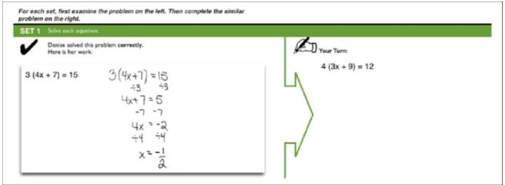
Borrowing & Reorganizing
Much of what we learn is borrowed from others and reorganized based on prior knowledge.
Implication: Novices perform better with worked examples. They could start by borrowing solutions before solving problems on their own.
Image copyright: Christina Areizaga Barbieri

Slide 9
Randomness as Genesis
New knowledge creation mirrors biological evolution – we try out solutions, test effectiveness and retain successful ones in memory. Trial & Error.
Others can then borrow and reorganize this new knowledge.

Slide 10
Narrow Limits of Change
The epigenetic system regulates evolutionary mutations to ensure gradual adaptation. Similarly, working memory limits the amount of novel information that we can process in one go to prevent overload.
Implication: Instructional strategies should reduce extrinsic load (avoid starting with unguided practice), maximize germane load (use chunking, for instance) and simplify intrinsic load.

Slide 11
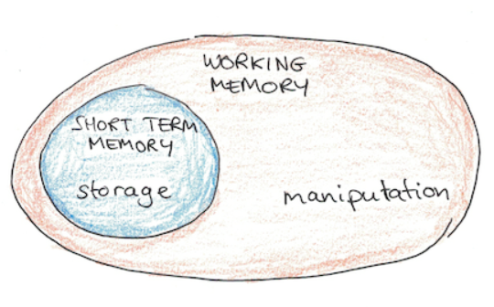
Environmental Organizing & Linking
Image copyright: Scott H Young
Working memory struggles with new information but can easily retrieve familiar knowledge from long-term memory. An expert doctor with vast stores of medical information can outperform a novice with stronger problem-solving skills.
Implication: Rather than teaching generic skills, which are extremely difficult to transfer, focus on deepening subject understanding, which could address domain-specific as well as interdisciplinary thinking skills.

Slide 12
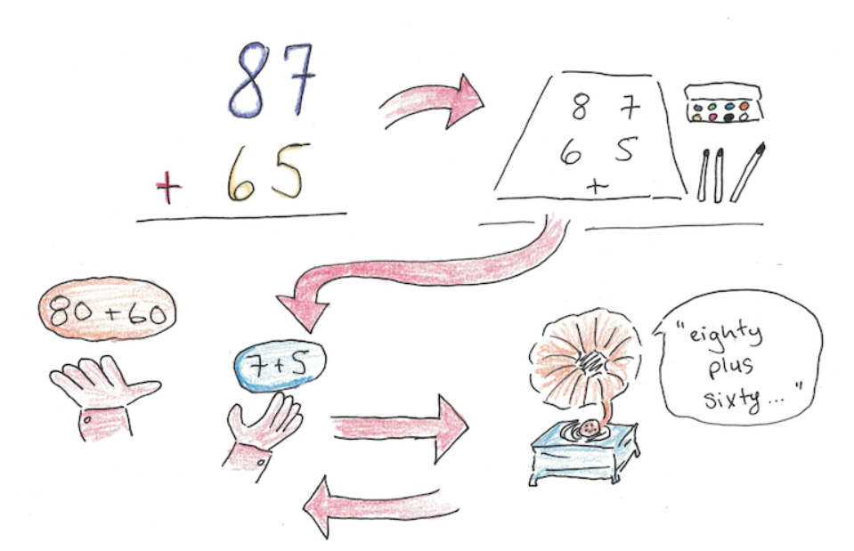
How Working Memory Works
Image copyright: Scott H Young

Slide 13
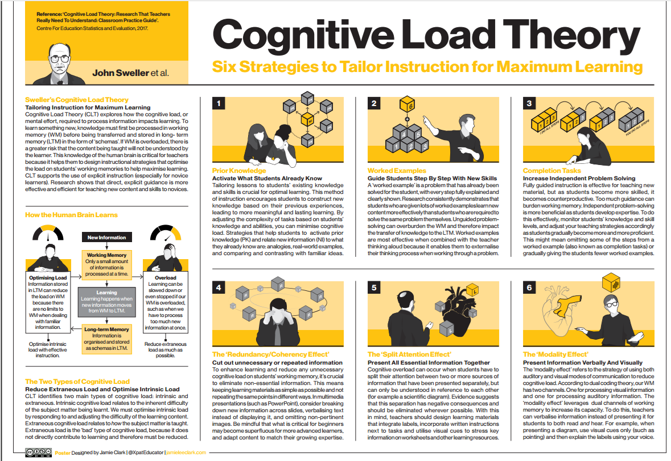

Slide 14
How the Human Brain Learns

Slide 15
CLT: Strategies to Maximise Learning

Slide 16
Richard Mayer’s Multimedia Learning
1. Coherence Principle – People learn better when extraneous words, pictures and sounds are excluded rather than included.
2. Signaling Principle – People learn better when cues that highlight the organization of the essential material are added. 3. Redundancy Principle – People learn better from graphics and narration than from graphics, narration and on-screen text.
4. Spatial Contiguity Principle – People learn better when corresponding words and pictures are presented near rather than far from each other on the page or screen.
5. Temporal Contiguity Principle – People learn better when corresponding words and pictures are presented simultaneously rather than successively.
6. Segmenting Principle – People learn better from a multimedia lesson is presented in user-paced segments rather than as a continuous unit.
7. Pre-training Principle – People learn better from a multimedia lesson when they know the names and characteristics of the main concepts.
8. Modality Principle – People learn better from graphics and narrations than from animation and on-screen text.
9. Multimedia Principle – People learn better from words and pictures than from words alone.
10. Personalization Principle – People learn better from multimedia lessons when words are in conversational style rather than formal style.
11. Voice Principle – People learn better when the narration in multimedia lessons is spoken in a friendly human voice rather than a machine voice.
12. Image Principle – People do not necessarily learn better from a multimedia lesson when the speaker’s image is added to the screen.

Slide 17
Coherence Principle
Attribution: Water bear Learning

Slide 18
Signalling Principle
Attribution: Water bear Learning

Slide 19
Redundancy Principle
Attribution: Water bear Learning

Slide 20
Spatial Contiguity Principle
Attribution: Water bear Learning

Slide 21
Temporal Contiguity Principle
Attribution: Water bear Learning

Slide 22
Segmenting Principle
Attribution: Water bear Learning

Slide 23
Pre-training Principle
Attribution: Water bear Learning

Slide 24
Modality Principle
Attribution: Water bear Learning

Slide 25
Multimedia Principle
Attribution: Water bear Learning

Slide 26
Personalisation Principle
Attribution: Water bear Learning

Slide 27
Voice Principle
Attribution: Water bear Learning

Slide 28
Image Principle
Attribution: Water bear Learning

